Slide 1

Real Estate Prices
Prediciting the values of houses based on their properties.

Slide 2
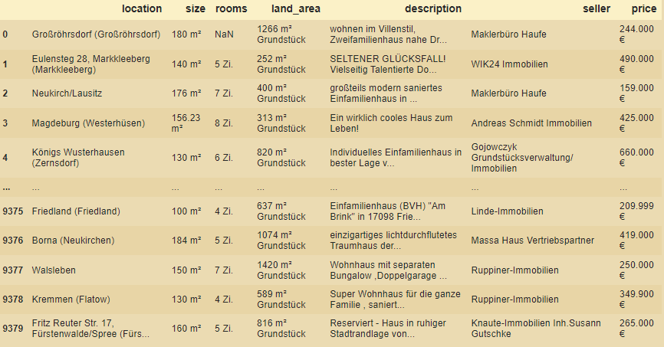
Getting the Data
Scraping internet for Data
www.immowelt.de
Roughly 30.000 offers
Location, size, offerer, price

Slide 3
About the Data
Houses for sale in Germany
Most of them from rural parts
Prices 50.000 - 1.000.000
Size 50sqm – 1000sqm
(1000sqm: houses with multiple appartments)

Slide 4
Working the Data
Location too many unique values
Categorizing them by size
Same with offerer
Categorizing them by type
Cleaned columns

Slide 5
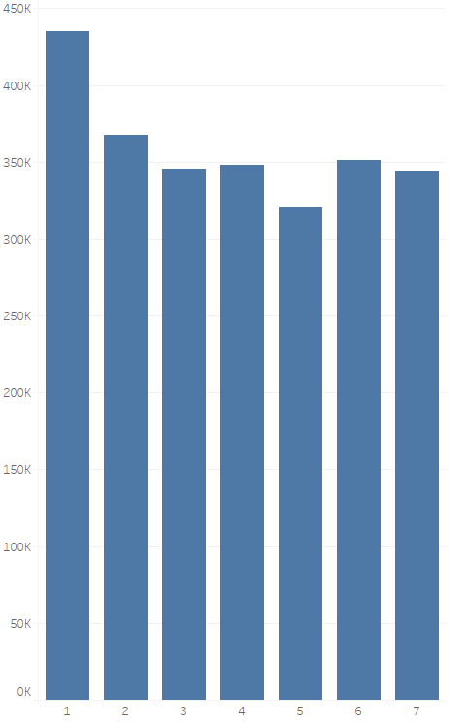
Prices by location
Categorized by Inhabitants:
> 1.000.000
500.000 – 1.000.000
200.000 – 500.000
90.000 – 200.000
50.000 – 90.000
25.000 – 90.000
< 25.000
Berlin, Hamburg, Munich more expensive than rest

Slide 6
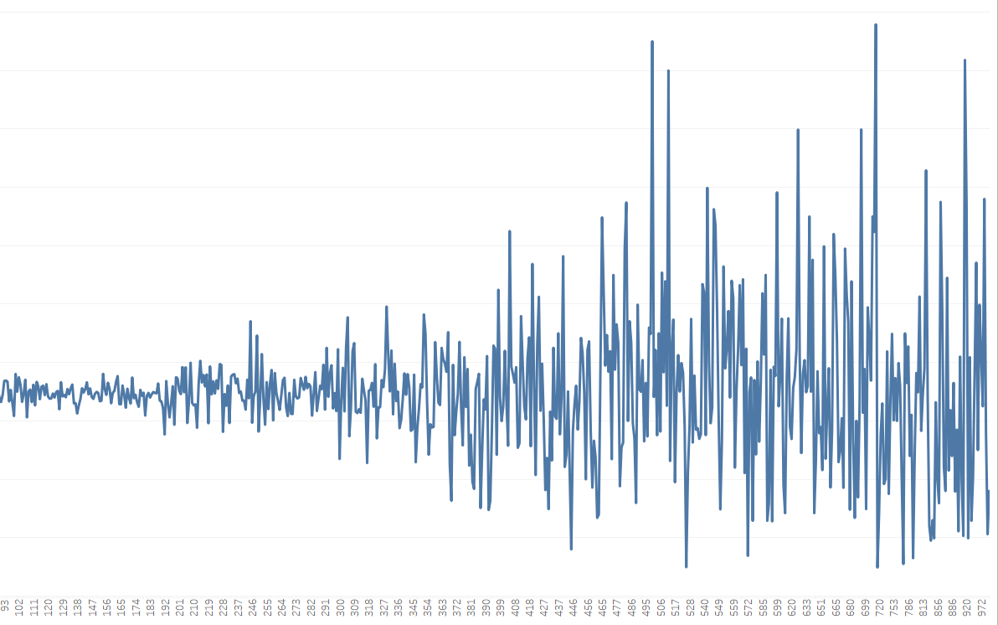
Prices by size
The bigger the house, the higher the variance
Why?
Maybe because big houses are not always better houses
Depending on location, they become hard to sell
That pushes the worth down

Slide 7
Predictions
Initial results really bad
Hyperparameter testing
Outlier removal
Multicolliniarity
PCA
Endresults better
Rmse = 200 000

Slide 8
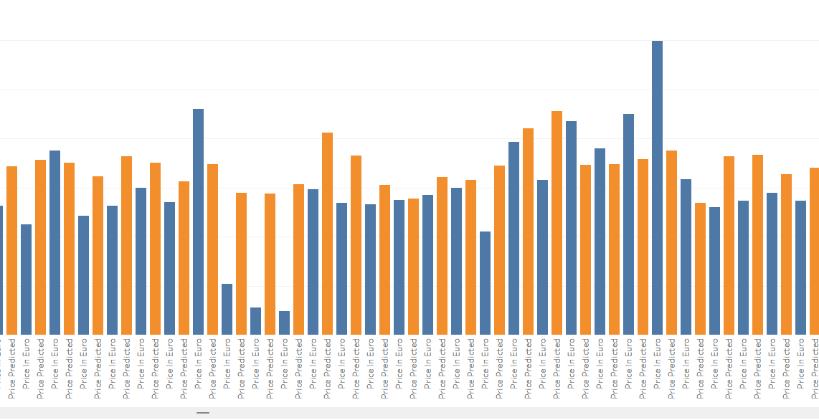

Slide 9
What could I do to get better predictions
If i had the time i would:
Get more Data
Get more features on that Data
Try out different categories for the location maybe

Slide 10
Thank you very Much
Any Questions?

